Slide 1



Team #2
Solar Car Project
Project Proposal

Slide 2
Team Member
Mechanical Engineers
Electrical Engineers
Keith Dalick
Emiliano Pantner
Adrian Cires
Shishir Rajbhandari
James Barge
Zachary Prisland

Slide 3
Body

Slide 4
Body
Deciding factors for the body design
  Light weight
  Aerodynamic
  Six square meters of Solar Array space
  Size requirements for race
  High strength

Slide 5
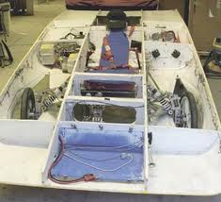
Proposed Design
Monocoque Construction
  Construction technique that utilizes the exterior of the body as the load bearing

Slide 6
Proposed Design
Designed using SolidWorks
Aerodynamic
  Flow analysis using CAD model
Carbon Fiber
  Light weight
  Very strong
  Shaped using wood molds
  High cost

Slide 7
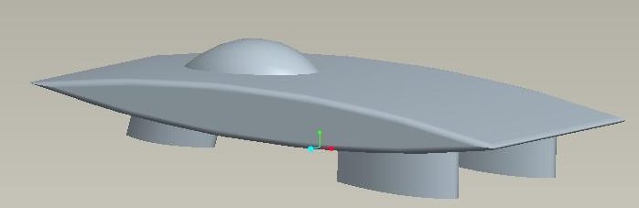
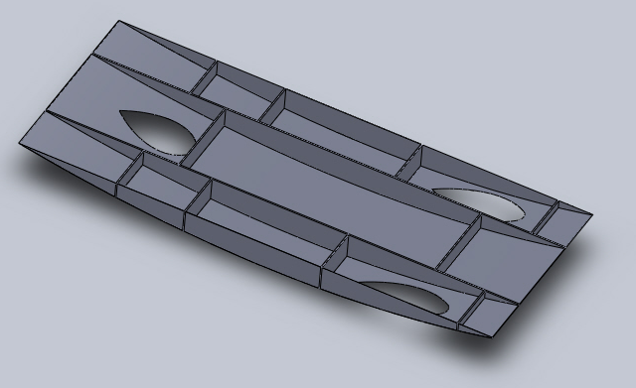
Proposed Design

Slide 8
Steering

Slide 9
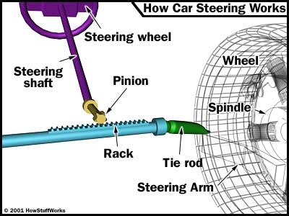
Proposed Design
Rack and Pinion Steering System
  Converts the rotational motion of the steering wheel into the linear motion needed to turn the wheels.
  It provides a gear reduction, making it easier to turn the wheels.

Slide 10
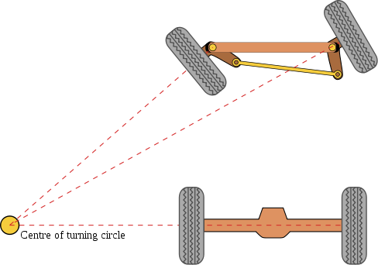
Statement of Work
Work with engineers designing body, and suspension of front two wheels.
Steering system will be designed in respect to body’s dimension and design.
Analysis of key components:
  Rack and Tie Rod dimensions
  Ackerman angle for steering, steering bar location,
  Kingpin axis, Steering Knuckle location
  Steering Stops
  Geometry and dimensions of the system.

Slide 11
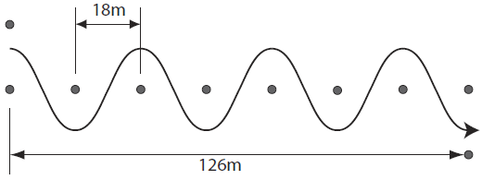
Statement of Work
Determine steering ratio
Analyze design using SolidWorks and working model to test linkage
Order parts needed for assembling the system
Verify steering system can complete all required tests in order to compete in race

Slide 12
Braking System

Slide 13
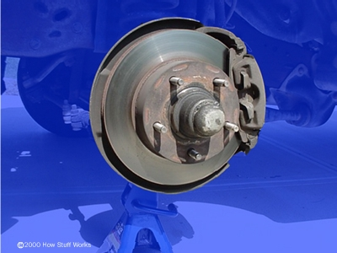
Proposed design
Two disc brake systems on front two wheels
Manual parking brake

Slide 14
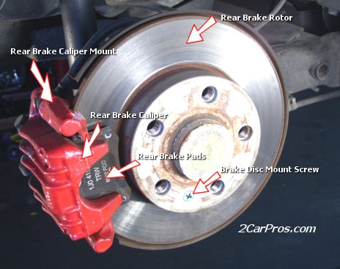
Statement of Work
Braking forces for each front tire will be calculated using an estimated total vehicle weight
Analysis and sizing of components
  Pedals
  Master cylinders
  Brake calipers
  Disc

Slide 15
Statement of Work
Race regulations
  Brake pad must have a contact area with the brake disc greater than 6.0 cm^2.
  Solar cars must be able to repeatedly stop from speeds of 50 km/h or greater, with an average deceleration, on level wetted pavement, exceeding 4.72 m/s^2.

Slide 16
Suspension

Slide 17
Suspension
The job of a car suspension
  Maximize the friction between the tires and the road surface
  Provide steering stability with good handling
  Ensure the comfort of the passengers
Approach
  Work with the engineers designing the body, braking and steering systems, and motor

Slide 18
Independent Suspension
Isolates vehicle by its points of contact from the road
Eliminates disadvantages of beam axle
  Loss of friction by the wheels
  Small maximum spring deflection
  No steering system control
  Over-steer

Slide 19
Front Suspension
Objective
  Design a double wishbone suspension for the front wheels
  Choose the right shock size
Shock size will depend on total weight of the car

Slide 20
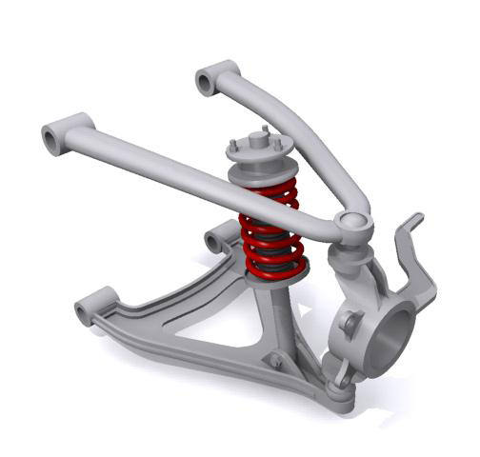
Double Wishbone
2 wishbone shaped links
  Provide a strong member to overcome forces from braking and acceleration
Fixed to the frame and upper and lower ball joints
Spring and damper between the 2 wishbones

Slide 21
Double Wishbone Advantages
Kinematics easily tuned and optimized
More control over camber angle (degree to which the wheels tilt in and out)
Minimize body roll and sway
More consistent steering feel

Slide 22
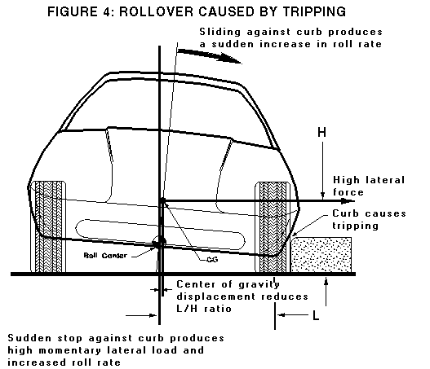
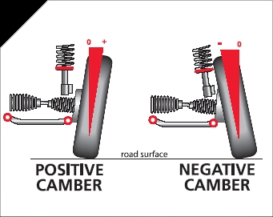
Roll and Camber Angle
Body Roll
Camber Angle

Slide 23
Rear Suspension
Objective
  Design a trailing-arm suspension for the rear wheel
  Choose the right shock size
Shock size will depend on total weight of the car
Motor will be mounted on rear wheel

Slide 24
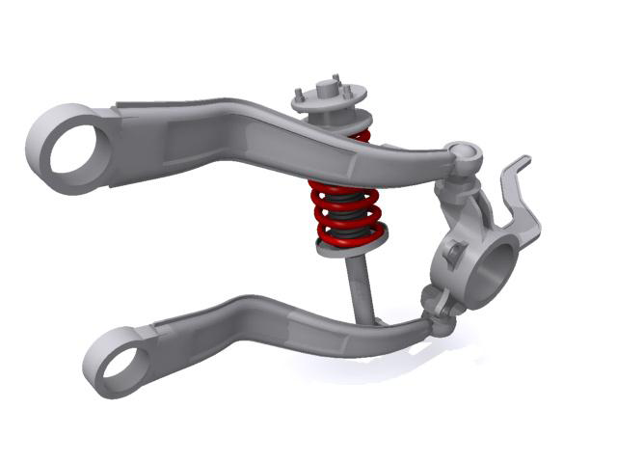
Trailing Arm
Arm joined at the front to the chassis
  Allows the rear to swing up and down
No side-to-side scrubbing
Only allows the wheel to move up and down

Slide 25
Suspension Design
System will be designed in SolidWorks
Custom parts include
  Trailing arm
  Wishbone arm links
  Hub
  Knuckle
  Fork-shaped link
Shocks will be bought according to calculated specifications

Slide 26
Suspension Testing
Individual then as a whole
Structural testing in SolidWorks
  Finite Element Analysis
  Fatigue and stress points
MSC Adams/Car to analyze and predict
  Roll and vertical forces
  Static loads
  Steering characteristics
  Wheel travel
Adjust camber angle, caster angle, toe pattern, roll center height, scrub radius, and scuff
  Smoother and more comfortable ride

Slide 27
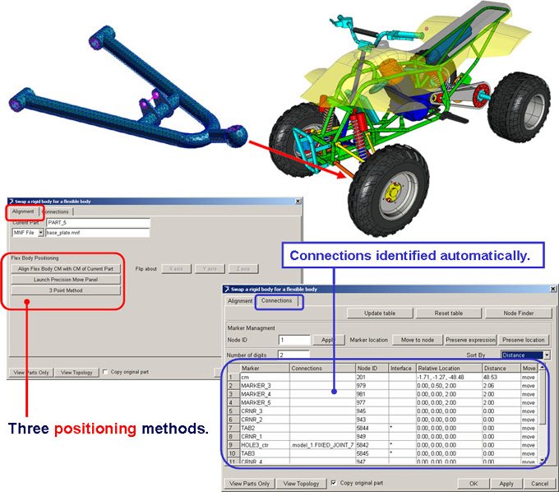
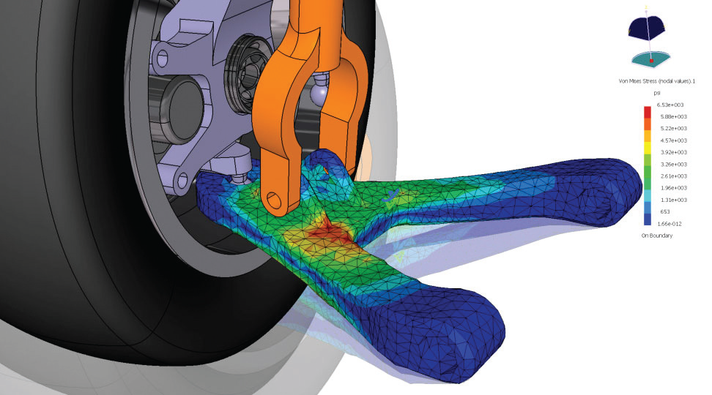
CAD Testing Examples
Positioning
Finite Element Analysis

Slide 28
Power Generation

Slide 29
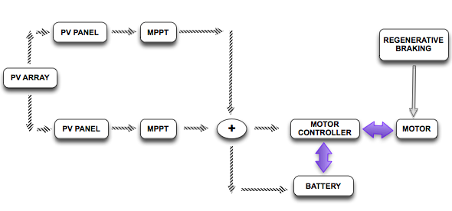
Power Generation

Slide 30
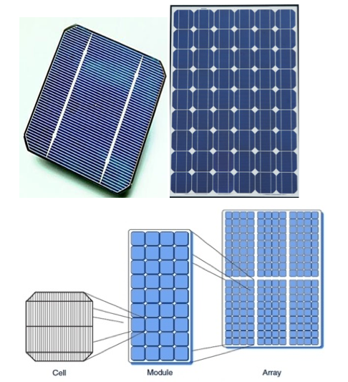
Cell, Module, Array

Slide 31
Solar Power
Performance:
Insolation
Semiconductor (Si, GaAs)
Temperature
Position of sun
Weather

Slide 32
Solar Cell
Single Junction Silicon
Amorphous Multi-junction Silicon
Cheap
Efficiency = 14 -16 %
Fill Factor > 0.4
V_{oc}, I_{sc}
Not-Flexible
Easily Broken
Not Waterproof
Expensive
Efficiency = 10-12 %
Fill Factor = 0.67-0.75
V_{oc}, I_{sc}
Flexible
Durable
Waterproof

Slide 33
Solar Module
32 - 36 Cells (series) / module
Encapsulate
Electrical parameters (I_{sc} – V_{oc})
Mismatch effect
Bypass diode
2 Bypass diodes/ 36-cell module

Slide 34
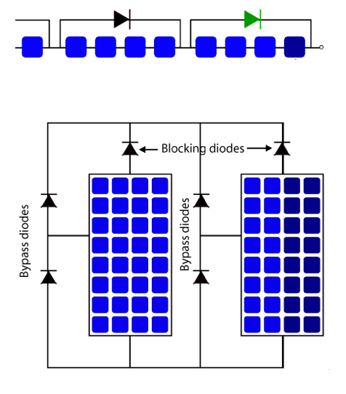
Bypass Diode, Blocking Diode

Slide 35
Solar Array
Series/Parallel module = Solar array
1 Blocking diode per module
Minimize cell temperature
PV Array Voltage > Battery Voltage
Max array power = 750 W

Slide 36
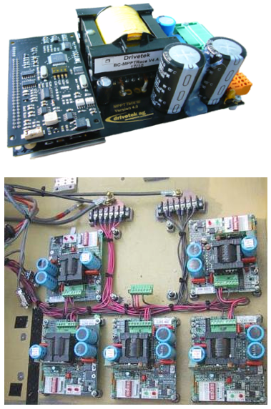
MPPT
Maximum Peak Power Tracker
DC:DC Converter
92-97% efficiency
Optimizes power output from panel while providing maximum amps into system
1 MPPT per solar panel
Winter, cloudy, hazy
Overcharge, reverse current protection

Slide 37
Regenerative Braking
Brake -> Motor -> Motor controller
Kinetic energy to electrical energy
Motor becomes generator
Charge stored in battery
60 – 70 % Efficiency (commercial E-V)
Friction + Regenerative Braking = Total Braking Output

Slide 38
Control System

Slide 39
Overview
Integration of control subsystems
Dashboard interface for driver input
Provides driver with telemetry and car systems status information

Slide 40
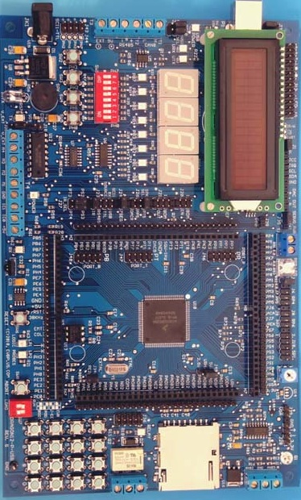
Master Control Unit
Microcontroller Based
  I/O lines
  Serial Ports
  Relays/Switches
  Servo control
  LCD Output
Communicates with and manages control subsystems

Slide 41
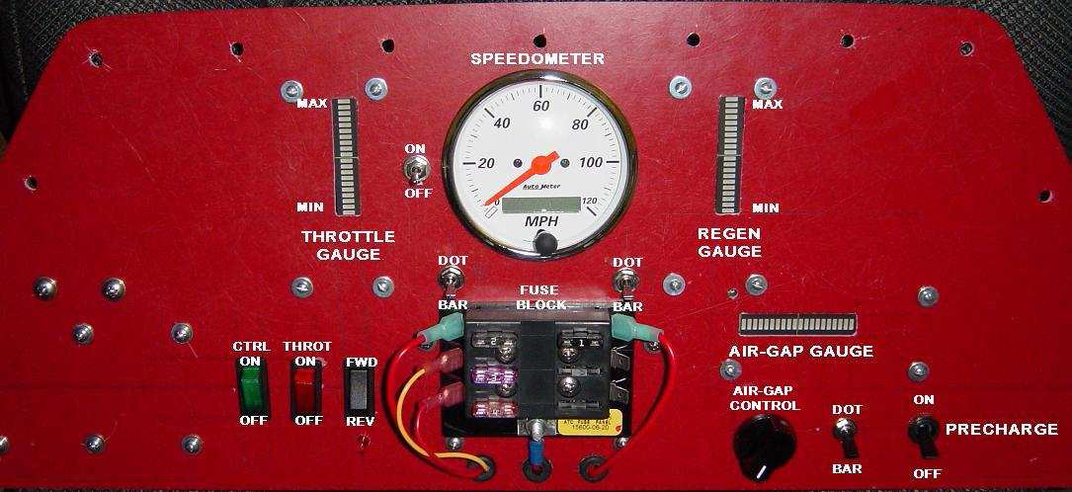
Dashboard
Current Features
  Speedometer
  Throttle Gauges
  Control Enable Switch
  Air Gap Adjustment
  Pre-charge Switch

Slide 42
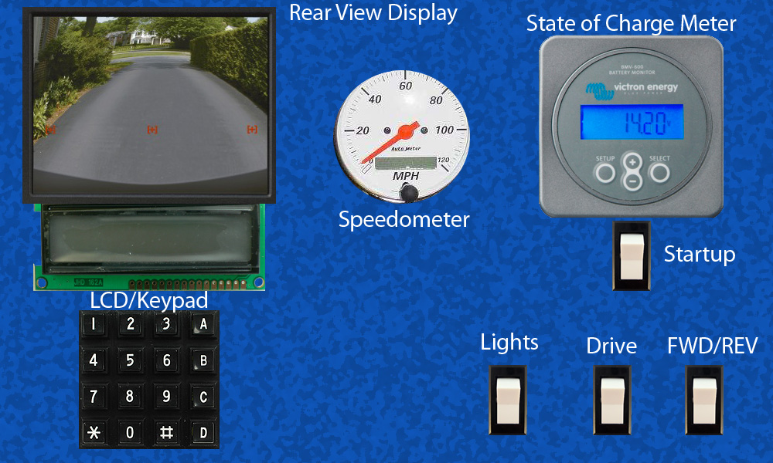
Dashboard
New Features
  State of Charge Meter
  LCD Display
  Video Display
  Light Switches
  Automated Startup
  Automated Gap Control

Slide 43
Management system

Slide 44
Overview
Management System
Stored Energy
Propulsion
Batteries
Protection Circuit
Wall Charging
State of Charge
Motor Controller
Power Control
Motor

Slide 45
Protection Circuit
Protection Type | Restraining Value
Over Voltage | 4.25 V
Under Voltage | 2.5 V
Over Current | 120 A
Over Temperature | 75 °C
Keep batteries in safe operating range
Send signal to Battery Management System (BMS)
Will require use of the microcontroller

Slide 46
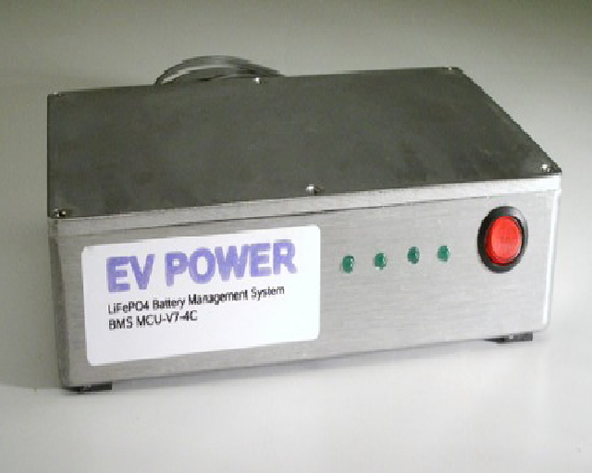
Battery Management System(BMS)
Designed for electric car use
Four signal inputs
Slowly powers down the system

Slide 47
Voltage Protection
Cell Modules will be used for voltage protection:
  Already connected to each cell
  Big series signal from BMS
  Break signal circuit if outside operational voltage

Slide 48
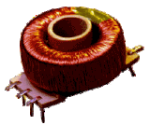
Current Protection
Current Transformer
Will send information to microcontroller
This information will also be used for SOC

Slide 49
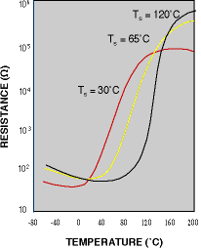
Temperature Protection
PTC Thermistor
  Positive temperature coefficient
Ideally hooked up directly through BMS
Cut off temperature, drastic increase in resistance

Slide 50
State of Charge (SOC)
The state of charge will display information for the driver about battery levels
  Voltage Display
  Current Display
  Temperature Display
  Battery Fuel Gauge (purchased device)
Will attempt to use information obtained from protection circuitry

Slide 51
Power Control
Creation of a power bus
  Voltage regulation (batteries/solar)
  Regenerative braking
Pre-charge circuit for motor controller
Electronic relay for shutdown

Slide 52
Budget & Schedule

Slide 53


Budget
Item | Cost
Carbon Fiber Composite | $ 1,800
Resin | $ 500
Solar Cell | $ 15,396
Power Tracker (MPPT) | $ 800
Camera & Display | $ 150
Misc Electrical | $ 500
Microcontroller | $ 180
Aluminum Stock | $ 108
Suspension Parts | $ 315
Braking System | $ 400
Steering System | $ 434
Misc Mechanical | $ 150
Driver Related Equipment | $ 435
Competition Fees | $ 7,000
Travel Expenses | $ 10,000
Total | $38,168
Budget estimate to date: $38,168
Budget from University: $5,000
Deficit: $33,168
Donations
  Hexcel
  SolidWorks

Slide 54
Major Milestones
System level design review November 15, 2010
Assemble lower body December 16, 2010
Assemble upper body January 21, 2011
Detailed design review and test plan January 27, 2011
Configure lower body February 21, 2011
Install solar arrays February 23, 2011
Total body configuration March 15, 2011
Final testing March 29, 2011

Slide 55
Questions???

Slide 56
Appendix

Slide 57
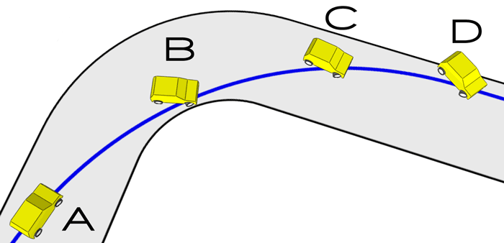
Over-steer

Slide 58
References
2CarPros. "How to Replace Rear Brake Pads and Rotor." n.d. 2CarPros - Car Questions & Answers. 26 August 2010 <http://www.2carpros.com/how_to/rear_brake_pads.htm >.
Barrys Tyre & Exhaust Centre. "Wheel Alignment." 2010. Barrys Tyre & Exhaust Centre. 29 October 2010 <http://www.barrystyre.co.uk/80610/info.php?p=5>.
CR Magnetics, Inc. CR Magnetics: Products. n.d. 29 October 2010 <http://www.crmagnetics.com/products/CR8750-P96.aspx>.
Dvorak, Paul. "Auto Suspension Design Made Easy." 18 August 2005. MachineDesign.com. 27 October 2010 <http://machinedesign.com/article/auto-suspension-design-made-easy-0818>.
EV Power, Australia Pty Ltd. EV Power: Products. n.d. 29 October 2010 <http://www.ev-power.com.au/-BMS-MASTER-UNITS-.html>.
Isaac-Lowry, Jacob. "Suspension Design: Types of Suspension." 22 August 2004. Automotive Articles. 27 August 2010 <http://www.automotivearticles.com/Suspension_Design_Types_of_Suspensions.shtml>.
MSC Adams. "What's New: Adams 2005." 2005. MSC Software. 29 October 2010 <http://www.mscsoftware.com/products/adams_whatsnew_2005.cfm?Q=396&Z=397>.
Nice, Karim. "How Car Steering Works." 31 May 2001. HowStuffWorks.com. 25 October 2010 <http://auto.howstuffworks.com/steering2.htm >.
—. "How Disc Brakes Work." 21 August 2000. HowStuffWorks.com. 26 October 2010 <http://auto.howstuffworks.com/auto-parts/brakes/brake-types/disc-brake.htm>.
Rapid-Racer. "Suspension." 2010. Rapid-Racer. 29 October 2010 <http://www.rapid-racer.com/suspension.php>.
Robert Q. Riley Enterprises, LLC. "Automobile Ride, Handling, and Suspension Design." 2009. Robert Q. Riley Enterprises, LLC. 29 October 2010 <http://www.rqriley.com/images/fig-4.gif>.
Spectrum Sensors and Controls, Inc. Spectrum Sensors and Controls: PTC - Engineering. n.d. 29 October 2010 <http://www.specsensors.com/ptc-engineering.asp>.

